Slide 1
CSY2082 Introduction to Artificial Intelligence
Ensemble Learning and Random Forests

Slide 2
Ensemble Learning

Slide 3

Ensemble Learning
Suppose you ask a complex question to thousands of random people, then aggregate their answers. In many cases you will find that this aggregated answer is better than an expert’s answer. This is called the wisdom of the crowd.
Similarly, if you aggregate the predictions of a group of predictors (such as classifiers or regressors), you will often get better predictions than with the best individual predictor. A group of predictors is called an ensemble; thus, this technique is called Ensemble Learning
You will often use Ensemble methods near the end of a project, once you have already built a few good predictors, to combine them into an even better predictor. In fact, the winning solutions in Machine Learning competitions often involve several Ensemble methods.
Notes:
https://miro.medium.com/max/1400/1*EVTtJMFat9WERM7BuShtkQ.png

Slide 4
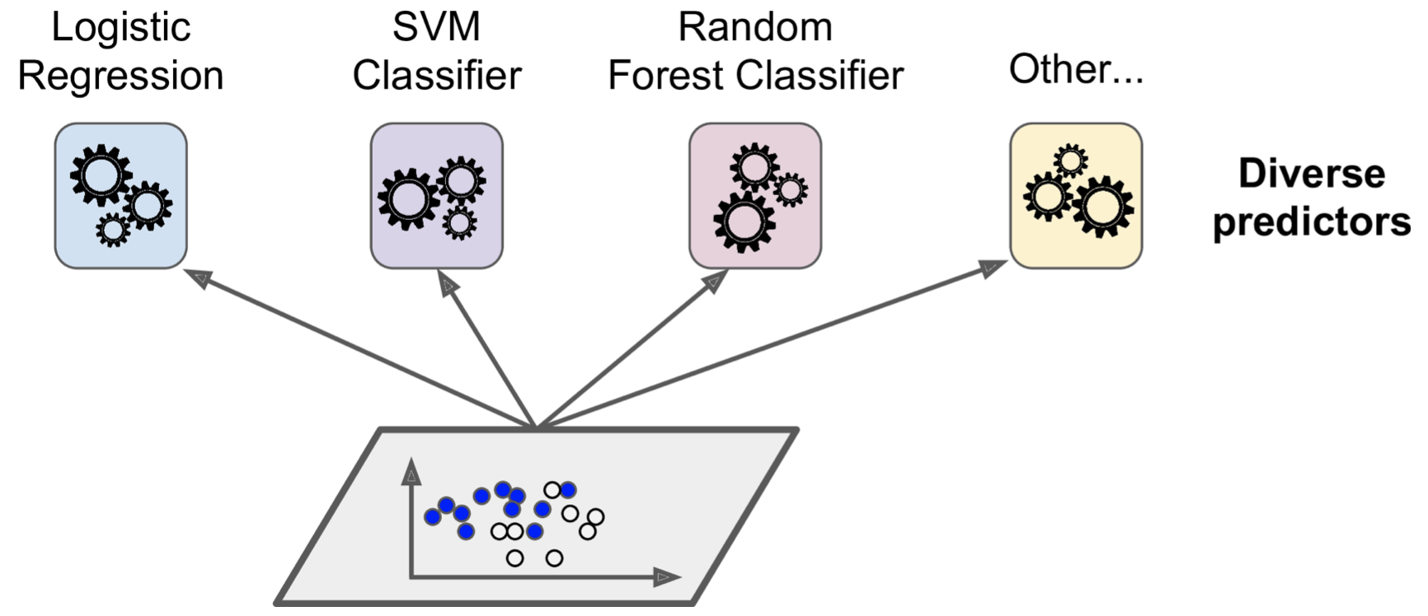
Voting Classifiers
Suppose you have trained a few classifiers, each one achieving about 80% accuracy.

Slide 5
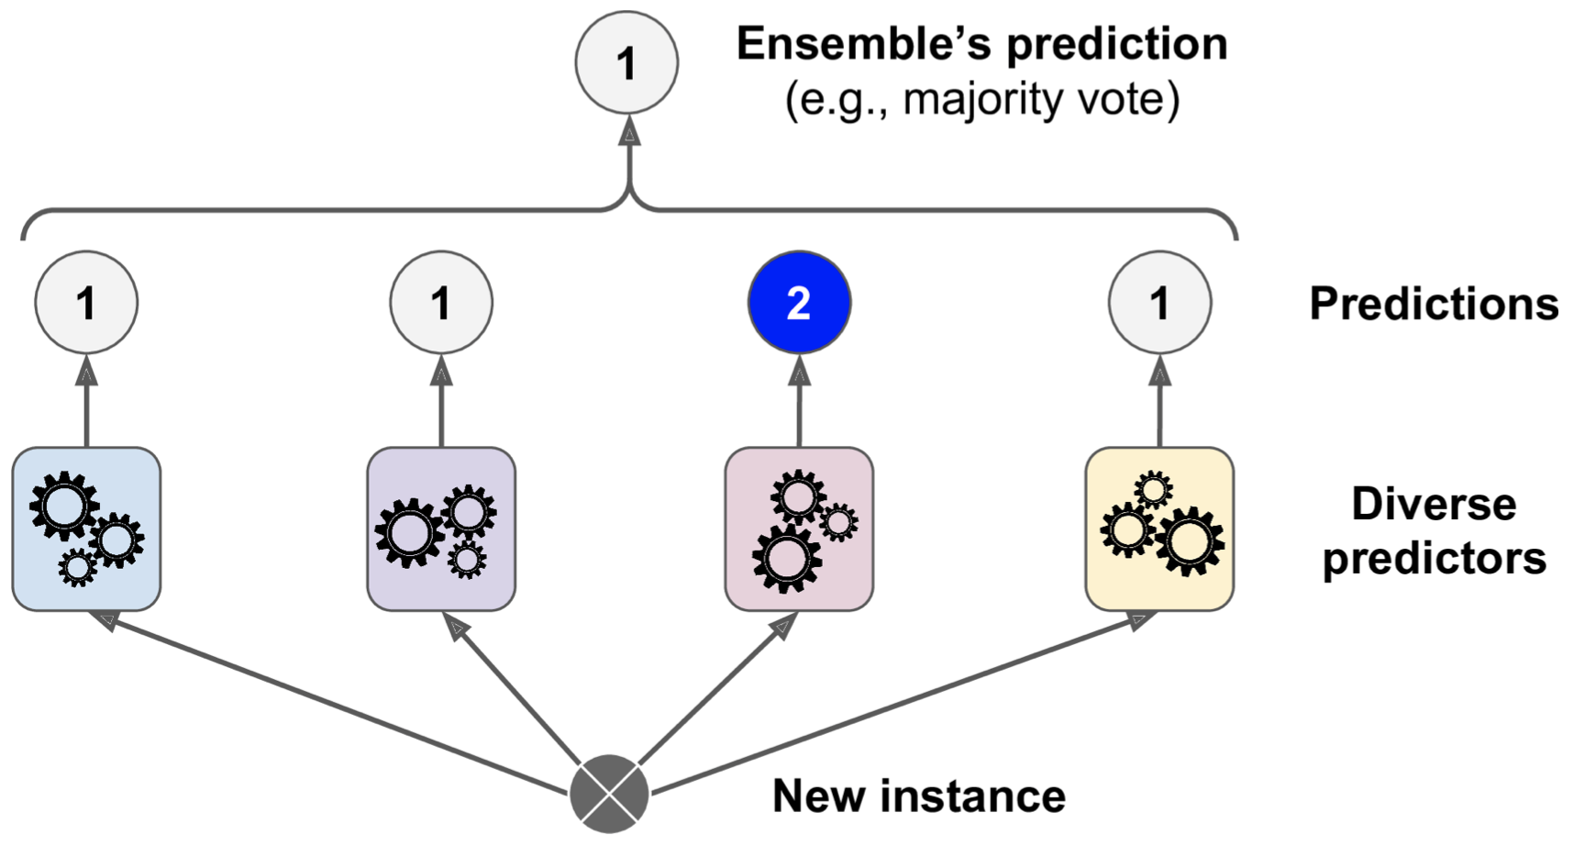
Voting Classifiers
A very simple way to create an even better classifier is to aggregate the predictions of each classifier and predict the class that gets the most votes. This majority-vote classifier is called a hard voting classifier
A few weak models -> strong model.

Slide 6
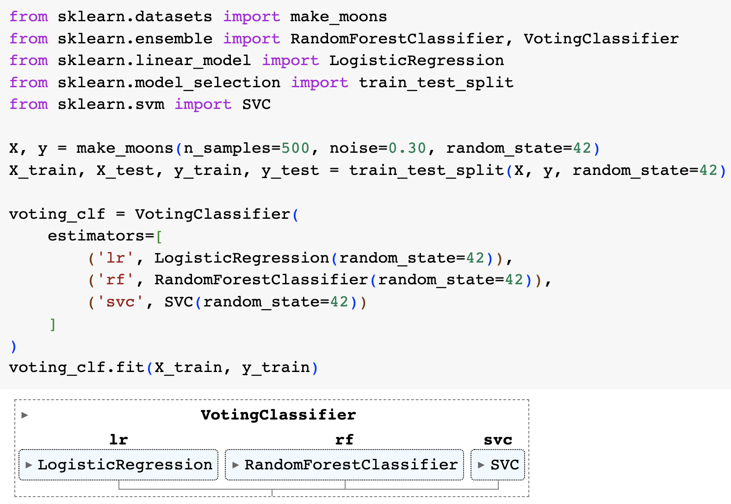
Voting Classifiers (hard) – make_moons data
Get a diverse set of classifiers is to use very different training algorithms.
(delete “random_state” in your own code)
LogisticRegression 0.864
RandomForestClassifier 0.896
SVC 0.888
VotingClassifier 0.904

Slide 7
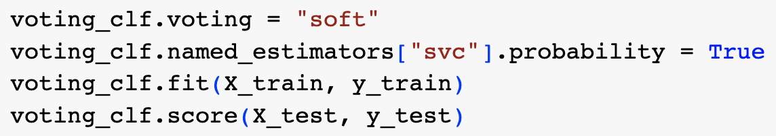
Voting Classifiers (soft)
If all classifiers are able to estimate class probabilities (i.e., they have a pre dict_proba() method), then you can tell Scikit-Learn to predict the class with the highest class probability, averaged over all the individual classifiers. This is called soft voting.
LogisticRegression 0.864
RandomForestClassifier 0.896
SVC 0.888
VotingClassifier 0.92

Slide 8
Random Forests

Slide 9
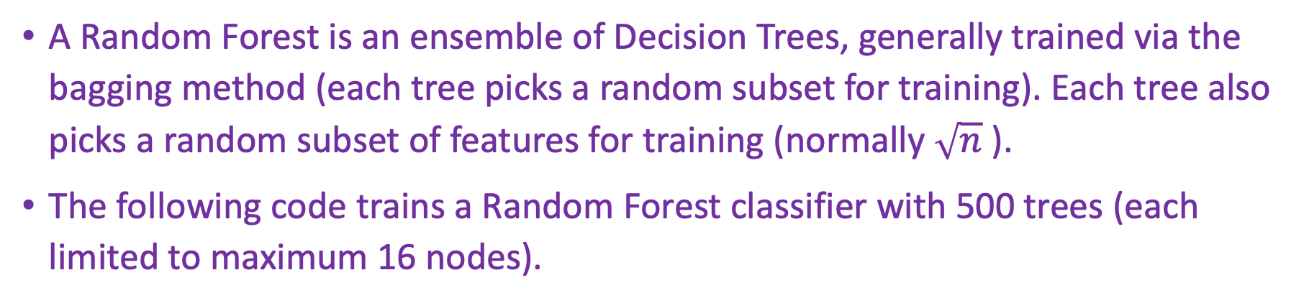
Random Forests
A Random Forest is an ensemble of Decision Trees, generally trained via the bagging method (each tree picks a random subset for training). Each tree also picks a random subset of features for training (normally $\sqrt{n}$ ).
The following code trains a Random Forest classifier with 500 trees (each limited to maximum 16 nodes).
from sklearn.ensemble import RandomForestClassifier
rnd_clf = RandomForestClassifier(n_estimators=500, max_leaf_nodes=16, n_jobs=-1)
rnd_clf.fit(X_train, y_train)
y_pred_rf = rnd_clf.predict(X_test)
Notes:
bag_clf = BaggingClassifier(
DecisionTreeClassifier(splitter="random", max_leaf_nodes=16),
n_estimators=500, max_samples=1.0, bootstrap=True, n_jobs=-1)

Slide 10
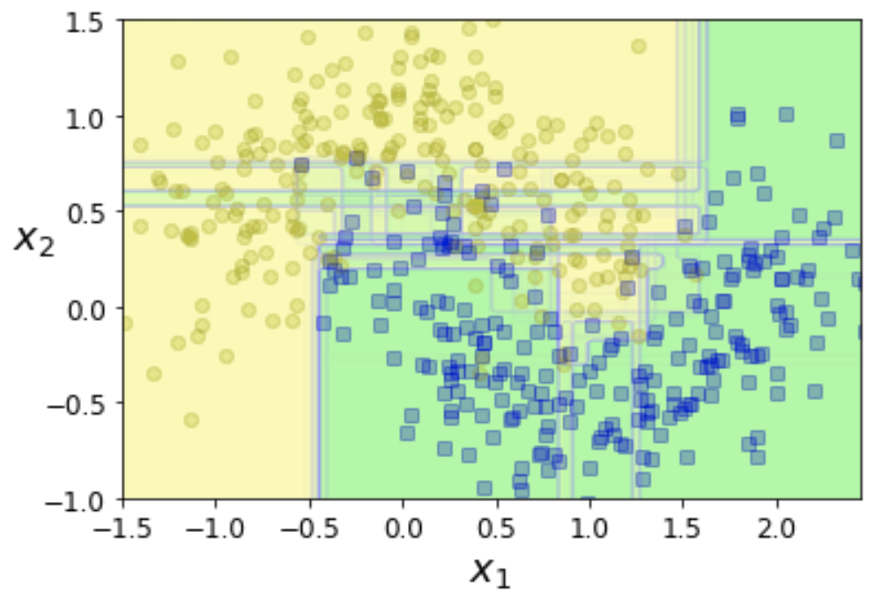
Random Forests
15 trees

Slide 11
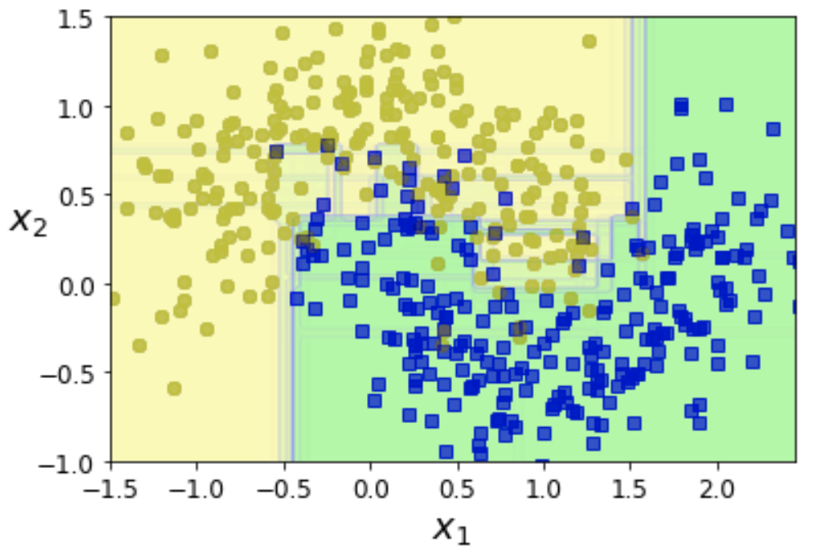
Random Forests
50 trees

Slide 12
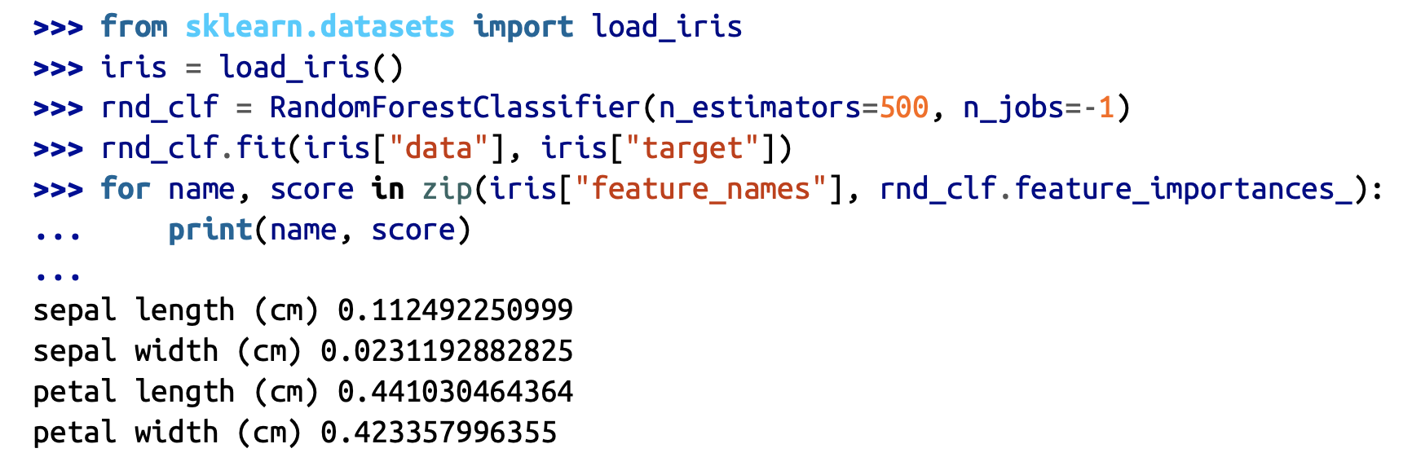
Feature Importance
A great quality of Random Forests is that they make it easy to measure the relative importance of each feature. Scikit-Learn measures a feature’s importance by looking at how much the tree nodes that use that feature reduce impurity on average (across all trees in the forest).
Scikit-Learn computes this score automatically for each feature after training, then it scales the results so that the sum of all importances is equal to 1. You can access the result using the feature_importances_ variable.

Slide 13
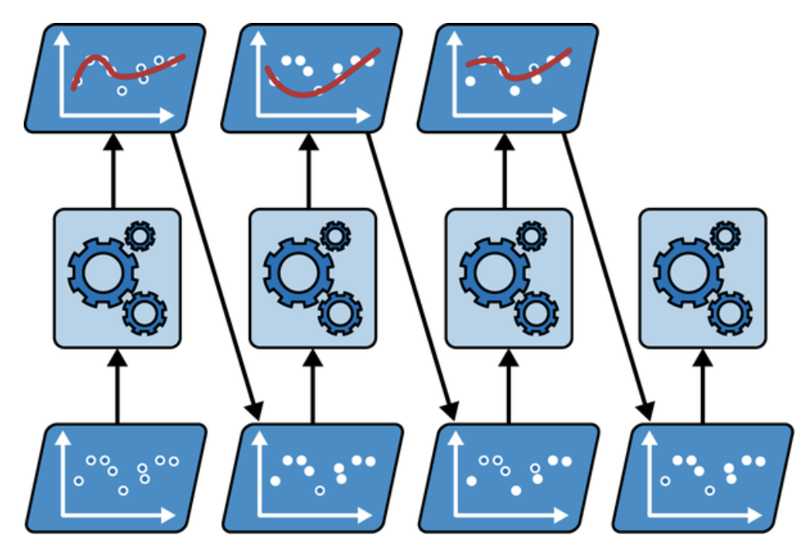
Boosting
AdaBoost sequential training with instance weight updates

Slide 14
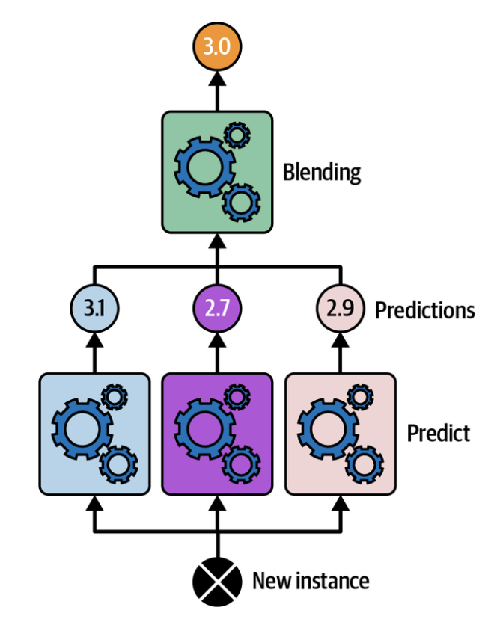
Stacking
aggregating predictions using a blending predictor

Slide 15
Exercise
Examine the classifiers listed on the following webpage and add some of these classifiers to your voting classifier to improve the overall performance.
https://scikit-learn.org/stable/auto_examples/classification/plot_classifier_comparison.html

